Slide 1
Resource Allocation in Wireless Cellular Networks
M. Rasti
Amirkabir University of Technology

Slide 2
Lecture 5 Outline
Existing Distributed Power Control Algorithms
TPC,TPC-PR,TPC-TR, TPC-SR, DFC
OPC, DTPC

Slide 3
The Power Control Problem
Maximizing aggregate Throughput
What is the centralized optimal solutions?

Slide 4

Opportunistic Power Control (OPC)
Corresponding power-update function for OPC
OPC:
Each user increases its transmit power as the interference at the receiver decreases and/or as its path gain increases
It does not guarantee an average SIR
p_{i}
$${\overline{p}}_{i}$$
OPC
R_{i}

Slide 5
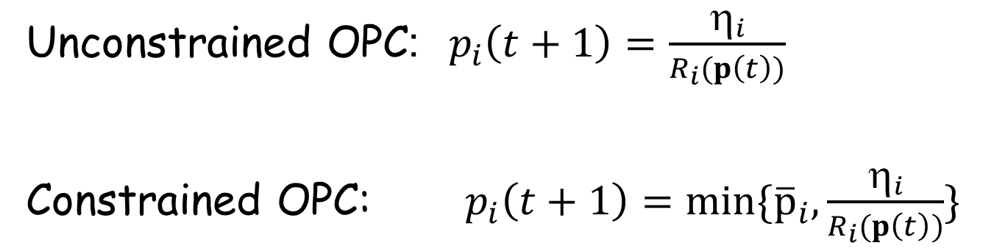

Target-SIR Tracking Power Control (TPC)
Unconstrained OPC:$p_{i}\left(t+1\right)=\frac{η_{i}}{R_{i}(p\left(t\right))}$
Constrained OPC:$p_{i}\left(t+1\right)=min\{{\overline{p}}_{i},\frac{η_{i}}{R_{i}(p\left(t\right))}\}$
p_{i}
$${\overline{p}}_{i}$$
OPC
R_{i}

Slide 6
Opportunistic Power Control (OPC)- Analysis
Q: Check if OPC power update function is a type-I or type-II standard or two-sided scalable function ?
Fixed-point existence
OPC power update function is a type II standard function
Notes:
In step 1 and 2 above, we obtain the fixed points using theoretical framework and in step 3 we investigate that the obtained fixed-point optimizes which objective function.

Slide 7
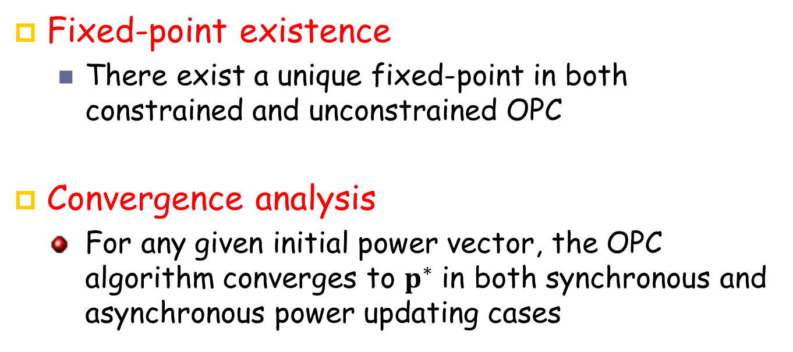
OPC- Analysis
Fixed-point existence
There exist a unique fixed-point in both constrained and unconstrained OPC
Convergence analysis
For any given initial power vector, the OPC algorithm converges to $p^{∗}$ in both synchronous and asynchronous power updating cases
Notes:
In step 1 and 2 above, we obtain the fixed points using theoretical framework and in step 3 we investigate that the obtained fixed-point optimizes which objective function.

Slide 8
OPC-Analysis
Corresponding Optimization Problem:
Maximum System Throughput:
OPC algorithm does not guarantee the optimum aggregate throughput but enhances the aggregate throughput as compared to existing distributed power control algorithms

Slide 9
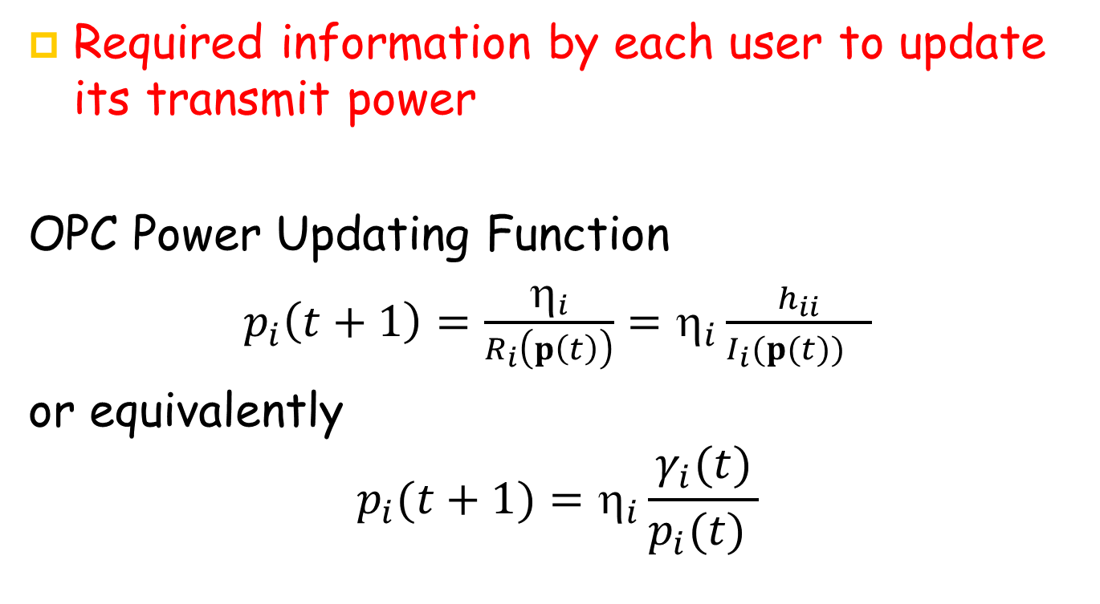
OPC-Analysis
Required information by each user to update its transmit power
OPC Power Updating Function
$p_{i}\left(t+1\right)=\frac{η_{i}}{R_{i}\left(p\left(t\right)\right)}=η_{i}\frac{h_{ii}}{{I_{i}(p(t))}_{}}$
or equivalently
$$p_{i}(t+1)=η_{i}\frac{γ_{i}(t)}{p_{i}(t) }$$

Slide 10
Lecture 3 Outline
Existing Distributed Power Control Algorithms
TPC,TPC-PR,TPC-TR, TPC-SR, DFC
OPC, DTPC

Slide 11
The Power Control Problem
Minimum outage ratio
where

Slide 12

TPC with Soft Removal (TPC-SR)
Corresponding power-update function for OPC
TPC-SR:
where and
p_{i}
$${\overline{p}}_{i}$$
TPC-SR
R_{i}

Slide 13
TPC-SR - Analysis
Q: Check if TPC-SR power update function is a type-I or type-II standard or two-sided scalable function ?
Fixed-point existence
TPC-SR power update function is a two-sided scalable function.
Notes:
In step 1 and 2 above, we obtain the fixed points using theoretical framework and in step 3 we investigate that the obtained fixed-point optimizes which objective function.

Slide 14
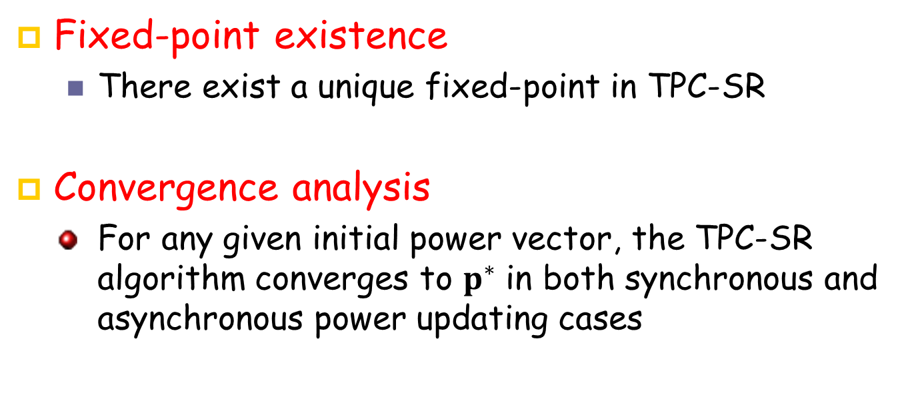
TPC-SR -Analysis
Fixed-point existence
There exist a unique fixed-point in TPC-SR
Convergence analysis
For any given initial power vector, the TPC-SR algorithm converges to $p^{∗}$ in both synchronous and asynchronous power updating cases
Notes:
In step 1 and 2 above, we obtain the fixed points using theoretical framework and in step 3 we investigate that the obtained fixed-point optimizes which objective function.

Slide 15
TPC-SR -Analysis
Corresponding Optimization Problem:
Minimum Outage:
TPC-SR algorithm does not guarantee the minimum outage but it reduces the outage ratio in infeasible system while the total consumed transmit power is also reduced, as compared to TPC.

Slide 16
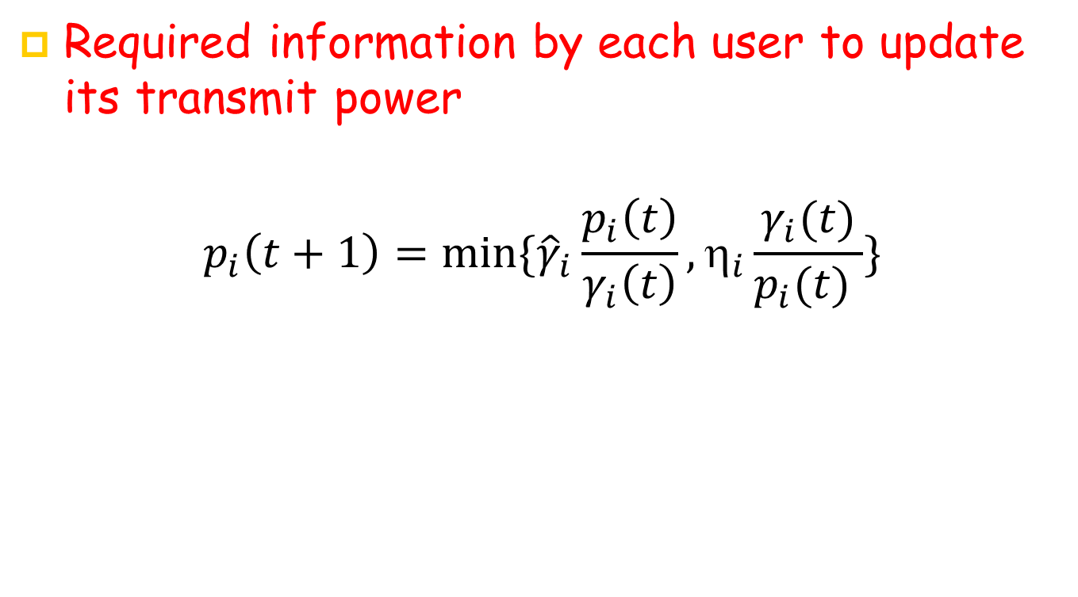
TPC-SR -Analysis
Required information by each user to update its transmit power
$$p_{i}\left(t+1\right)=min\{{\hat{γ}}_{i}{\frac{p_{i}\left(t\right)}{γ_{i}\left(t\right)},η}_{i}\frac{γ_{i}(t)}{p_{i}(t) }\}$$

Slide 17
Lecture 5 Outline
Existing Distributed Power Control Algorithms
TPC,TPC-PR,TPC-TR, TPC-SR, DFC
OPC, DTPC

Slide 18

Summary of distributed power control algorithms examined so far
TPC:
TPC-TR or TPC-PR:
OPC:
TPC-SR:
p_{i}
TPC
$${\overline{p}}_{i}$$
OPC
TPC-SR
TPC-TR or TCP-PR,
R_{i}

Slide 19
Summary
Algorithm | Optimization Problem | Pros. | Cons.
Target-SIR Tracking Power Control (TPC) | Minimum aggregate transmit power subject to users’ target-SIR | Existence of fixed-point Convergence Satisfying the objective function in feasible system | Lack of a distributed mechanism to check the feasibility Fixed target-SIR assignment
TPC with Permanent Removal (TPC-PR) | Minimum outage ratio | Convergence Reduces outage ratio | Permanent Removal
TPC with Temporary Removal (TPC-TR) | Minimum outage ratio | Reduces outage ratio in infeasible system (if it converges) | Possible lack of fixed-point (Possible power oscillation)
TPC with Soft Removal (TPC-SR) | Minimum outage ratio | Convergence Reduces outage ratio Reduces aggregate transmit power | Does not guarantee the minimum outage
Opportunistic Power Control (OPC) | Maximum System throughput | Existence of fixed-point Convergence Improves system throughput | Unfairness

Slide 20
Summary
P1) Gradual Temporary Removal with Feasibility Check (resolved by DFC)
Algorithm | Optimization Problem | Pros. | Cons.
Target-SIR Tracking Power Control (TPC) | Minimum aggregate transmit power subject to users’ target-SIR | Existence of fixed-point Convergence Satisfying the objective function in feasible system | Lack of a distributed mechanism to check the feasibility Fixed target-SIR assignment
TPC with Permanent Removal (TPC-PR) | Minimum outage ratio | Convergence Reduces outage ratio | Permanent Removal
TPC with Temporary Removal (TPC-TR) | Minimum outage ratio | Reduces outage ratio in infeasible system (if it converges) | Possible lack of fixed-point (Possible power oscillation)
TPC with Soft Removal (TPC-SR) | Minimum outage ratio | Convergence Reduces outage ratio Reduces aggregate transmit power | Does not guarantee the minimum outage
Opportunistic Power Control (OPC) | Maximum System throughput | Existence of fixed-point Convergence Improves system throughput | Unfairness
P2) Optimizing System Throughput Subject to Users' SIRs Constraint
(Resolved by DTPC)

Slide 21
New Problems Statements
P1) Gradual removal problem (resolved by DFC)
P2) Optimizing System Throughput Subject to Users' SIRs Constraint (Resolved by DTPC)

Slide 22
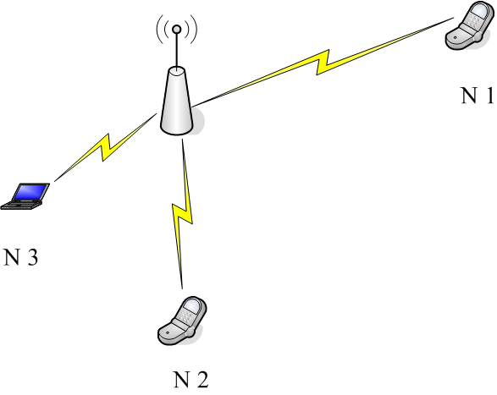
Motivating Example
Suppose that the target-SIRs of each set of users {N1}, {N2}, {N3}, and {N2, N3} are feasible and for any other set of users are infeasible
The minimum outage is 1/3, obtained by a transmit power vector that satisfies the target-SIRs for the set {N2, N3}. Only the transmit power vectors satisfying the target-SIRs for the sets {N1} or {N2, N3} are Pareto efficient, among which the transmission power vector satisfying the target-SIRs for the set {N1} does not minimize the outage.

Slide 23
Gradual Removal Problem: Pareto and Energy Efficient Power Control
Let denote the supported users by
And the non-supported users by

Slide 24
Gradual Removal Problem: Pareto and Energy Efficient Power Control
Pareto efficiency
A transmit power Pareto dominates another vector
if
A transmit power is Pareto efficient if there is no other transmit power vector which dominates it.
Pareto and energy efficient power control: A transmit power is Pareto and energy efficient if it:
is Pareto efficient
is the solution of

Slide 25
Pareto and Energy Efficient Power Control
Lemma 1
A transmit power is Pareto efficient if and only if for any the target-SIRs for users in the set are not feasible
Lemma 2
If a transmit power solves the minimum outage problem then it is Pareto efficient. The inverse is not necessarily true, i.e., a Pareto-efficient transmit power vector does not necessarily minimize the outage
Lemma 3
If a transmit power is Pareto and energy efficient, all transmitting users reach their target-SIR with minimum aggregate transmit power

Slide 26
Pareto and Energy Efficient Power Control
Lemma 1
A transmit power is Pareto efficient if and only if for any the target-SIRs for users in the set are not feasible
Lemma 2
If a transmit power solves the minimum outage problem then it is Pareto efficient. The inverse is not necessarily true, i.e., a Pareto-efficient transmit power vector does not necessarily minimize the outage
Lemma 3
If a transmit power is Pareto and energy efficient, all transmitting users reach their target-SIR with minimum aggregate transmit power
Under a Pareto and energy efficient power allocation, the aggregate transmit power to support a given subset of users whose target SIRs are reachable is minimized, but no additional user (if any exists) can be supported at the same time

Slide 27
SIR Feasibility
The target SIRs for a given subset of users are feasible if a power vector exists that satisfies the target-SIRs for the users in that set
The target-SIRs of users in the set are feasible from a given user i's point of view, where , if the following inequality holds
How to enable each user to check the feasibility of the system from its own point of view in a distributed manner, when that user is active, or removed.

Slide 28
DFC Algorithm
Theorem: Let denote the fixed-point of the power-update function for the TPC when only users in the set are active (transmitting),
Given a user if the target-SIRs for the set are feasible from that user's point of view, then
Given new user i, i.e., , if the target-SIRs for the set are feasible from that user's point of view, then

Slide 29
The Distributed Pareto and Energy-Efficient Power Control with Feasibility Check (DFC)
The DFC Power Updating function;
Where ,
and ,
p_{i}
TPC
TPC-FC
TPC-TR or TCP-PR
R_{i}

Slide 30
DFC-Analysis
Theorem (Existence of fixed point): There exists at least one fixed-point for the power-update function of the DFC.
Theorem (Pareto and energy efficiency): Any fixed-point for the power-update function of the DFC is Pareto and energy-efficient.
Theorem (Outage minimization): When the target-SIRs for all users are the same, any fixed-points of the power-update function of the DFC minimizes the outage probability.

Slide 31
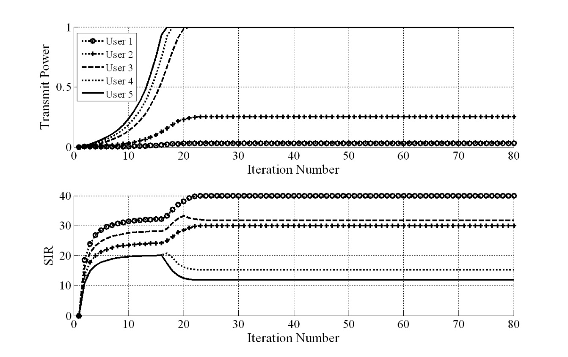
Simulation Results
TPC

Slide 32
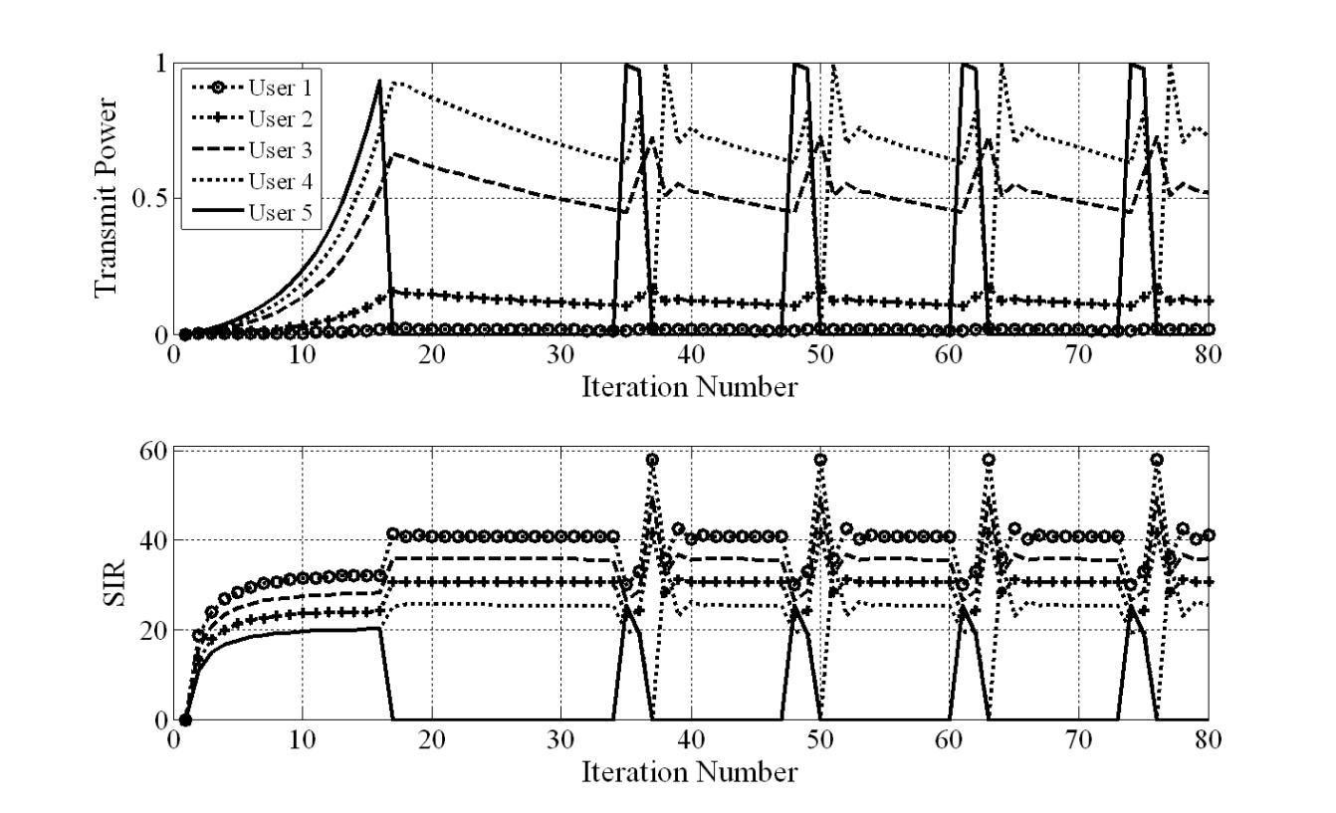
Simulation Results
TPC-TR

Slide 33
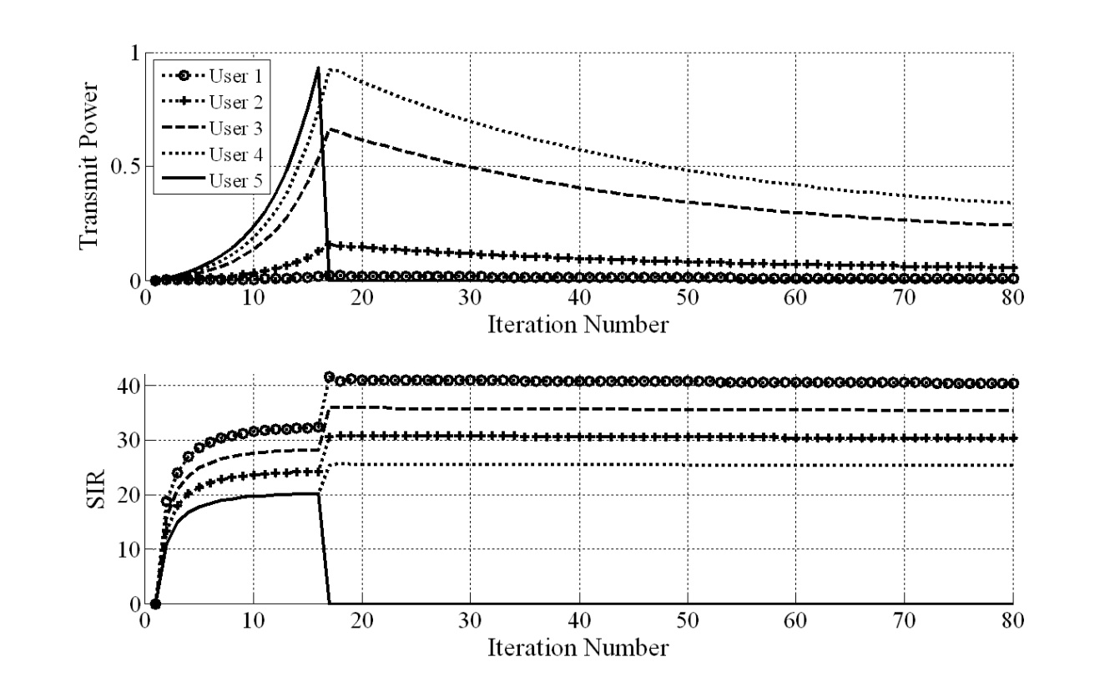
Simulation Results
DFC

Slide 34
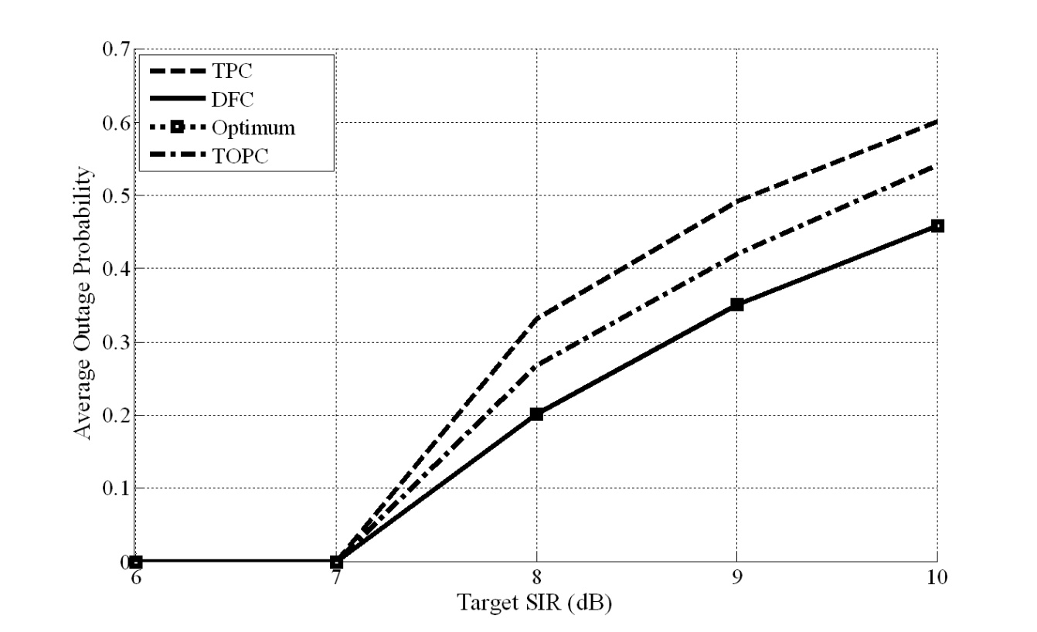
Simulation Results
Average Outage Probability in a single-cell wireless networks

Slide 35
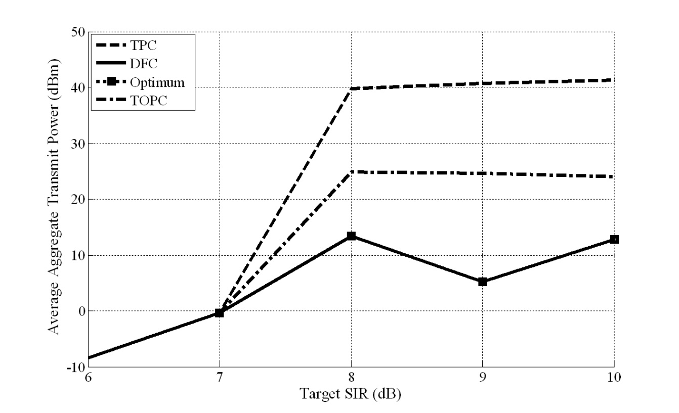
Simulation Results
Average aggregate transmit power in a single-cell wireless network

Slide 36
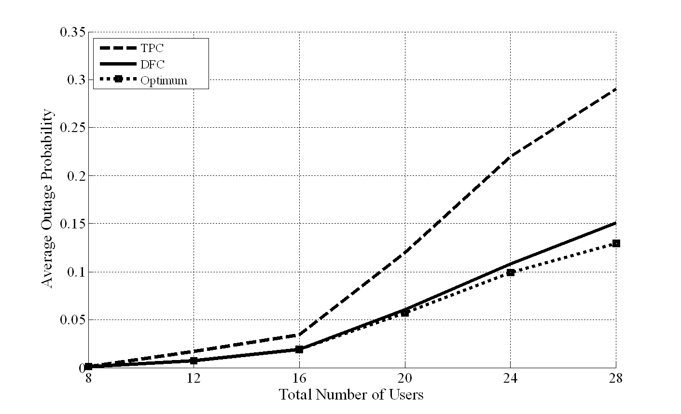
Simulation Results
Average Outage Probability in a 4-cell wireless network

Slide 37
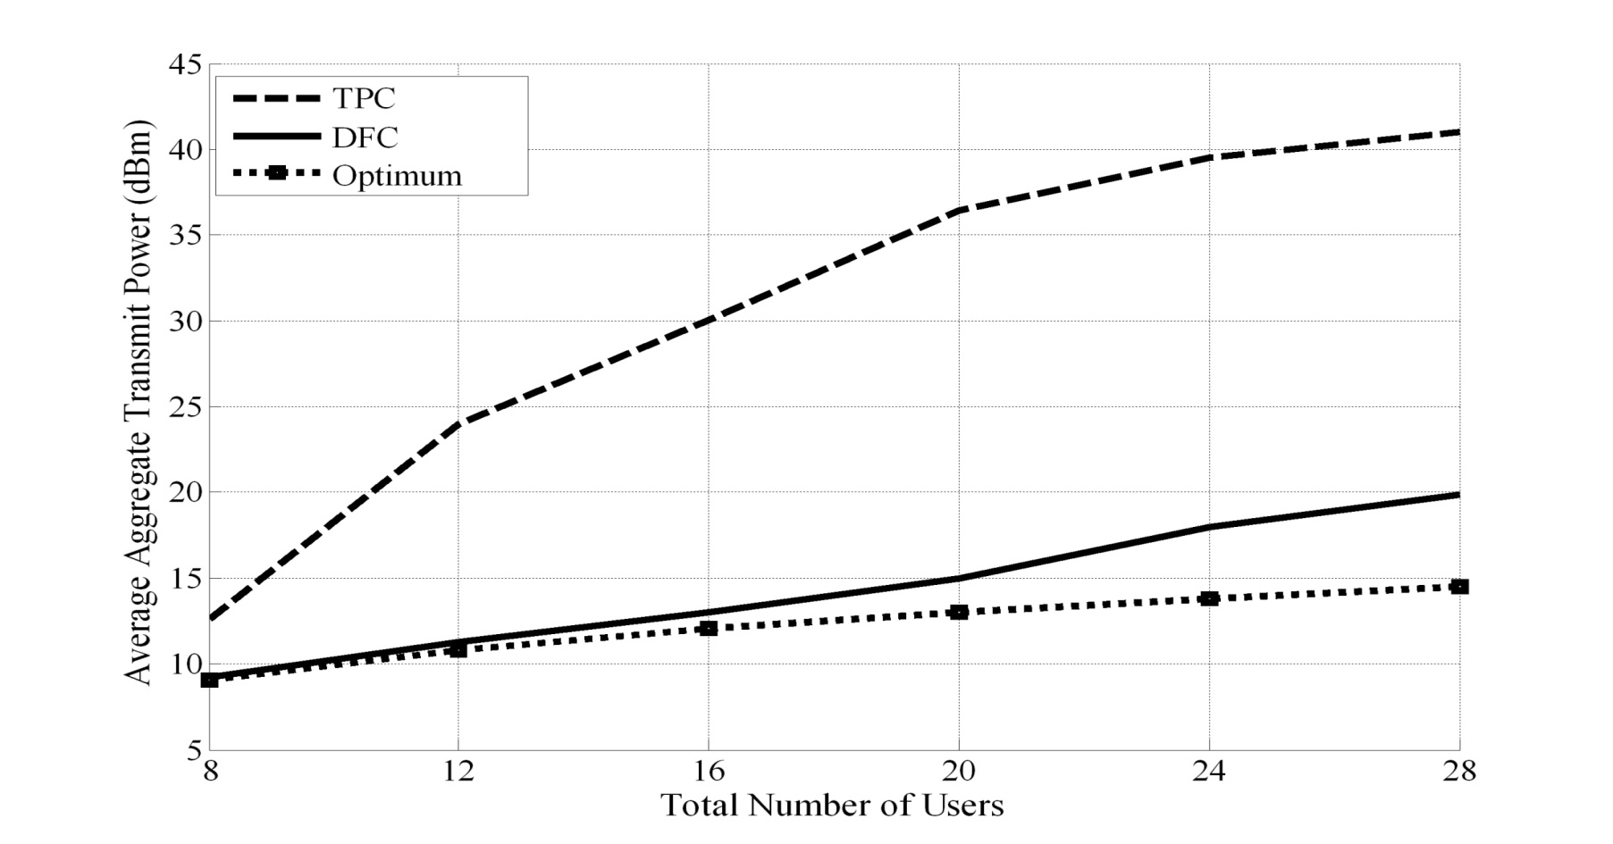
Simulation Results
Average aggregate transmit power in a 4-cell wireless network

Slide 38
Lecture 5 Outline
Existing Distributed Power Control Algorithms
TPC,TPC-PR,TPC-TR, TPC-SR, DFC
OPC, DTPC

Slide 39
New Problems Statements
P1) Gradual removal problem
P2) Optimizing System Throughput Subject to Users' SIRs Constraint

Slide 40
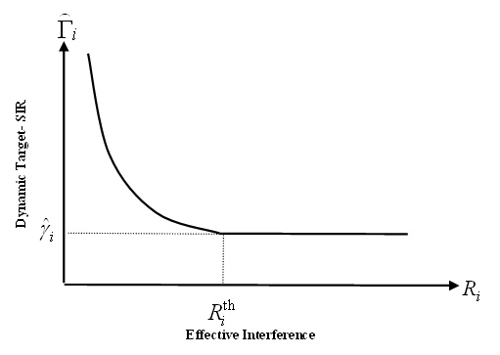
Dynamic Target-SIR Tracking (DTPC)
Dynamic Target-SIR Tracking
where
To be continuous:

Slide 41
Dynamic Target-SIR Tracking (DTPC)
Corresponding power-update function for DTPC
p_{i}
$${\overline{p}}_{i}$$
DTPC
R_{i}

Slide 42
DTPC-Analysis
Q: Check if DTPC power update function is a type-I or type-II standard or two-sided scalable function ?
DTPC power update function is a two-sided scalable function
Notes:
In step 1 and 2 above, we obtain the fixed points using theoretical framework and in step 3 we investigate that the obtained fixed-point optimizes which objective function.

Slide 43
DTPC -Analysis
Fixed-point existence
There exist a unique fixed-point in DTPC
Convergence analysis
For any given initial power vector, the DTPC algorithm converges to its unique fixed-point in both synchronous and asynchronous power updating cases
Notes:
In step 1 and 2 above, we obtain the fixed points using theoretical framework and in step 3 we investigate that the obtained fixed-point optimizes which objective function.

Slide 44
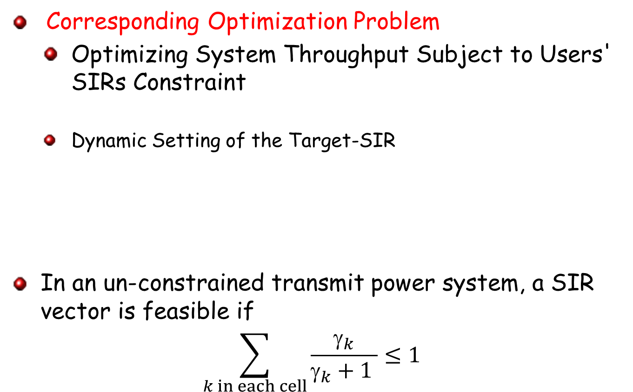
DTPC-Analysis
Corresponding Optimization Problem
Optimizing System Throughput Subject to Users' SIRs Constraint
Dynamic Setting of the Target-SIR
In an un-constrained transmit power system, a SIR vector is feasible if
$$\sum_{k in each cell}{\frac{γ_{k}}{γ_{k}+1 }}≤1$$

Slide 45
DTPC-Analysis
Theorem (Improvement in System Throughput by DTPC): By using DTPC for a given feasible set of minimum target-SIRs, the system throughput is improved as compared to TPC, while guaranteeing that all users are supported at least with their minimum target-SIRs

Slide 46

DTPC-Analysis
Required information by each user to update its transmit power
$$p_{i}\left(t+1\right)=max\{{\hat{γ}}_{i}{\frac{p_{i}\left(t\right)}{γ_{i}\left(t\right)},η}_{i}\frac{γ_{i}(t)}{p_{i}(t) }\}$$

Slide 47
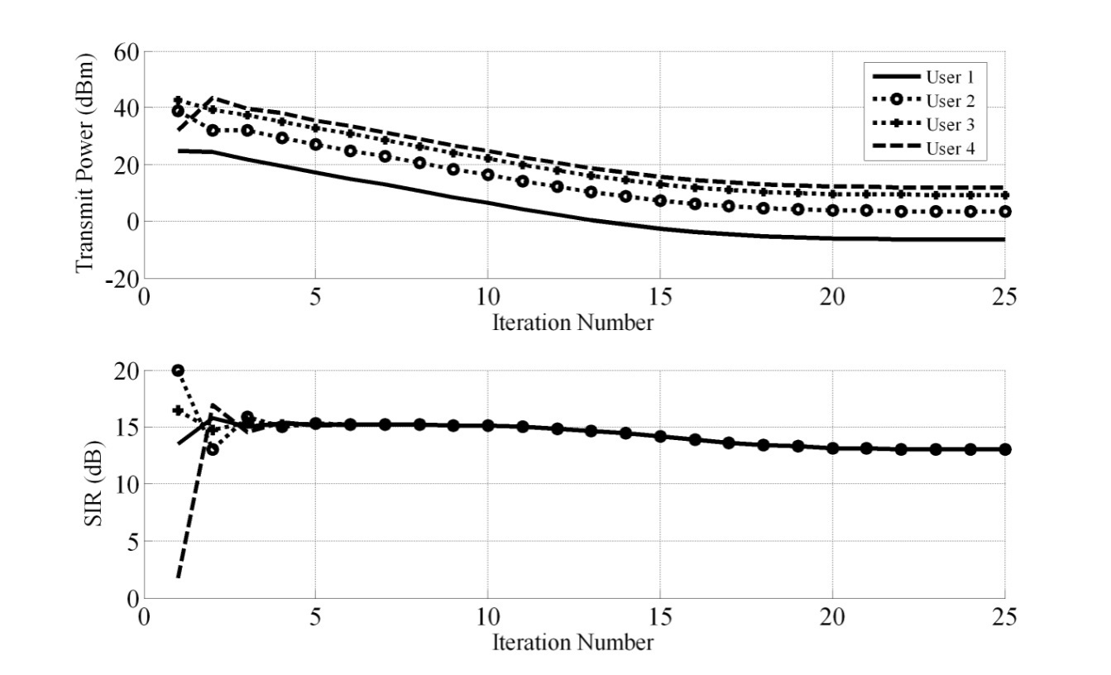
Simulation Results
TPC in a 4-users system

Slide 48
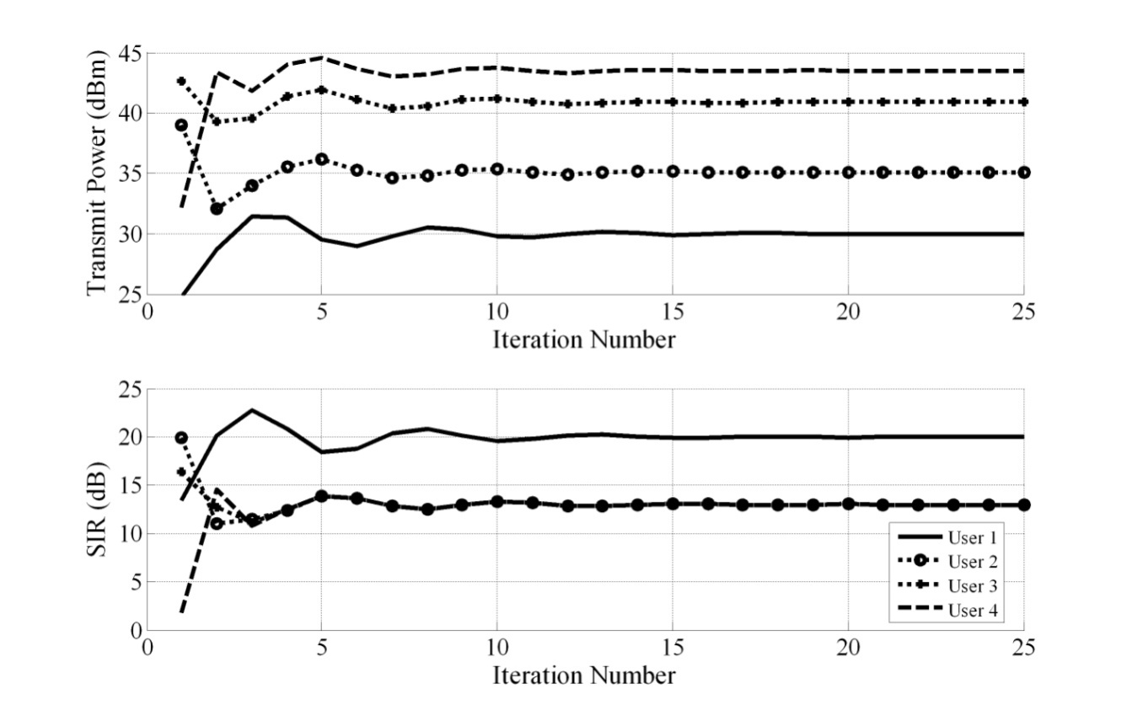
Simulation Results
DTPC in a 4-users system

Slide 49
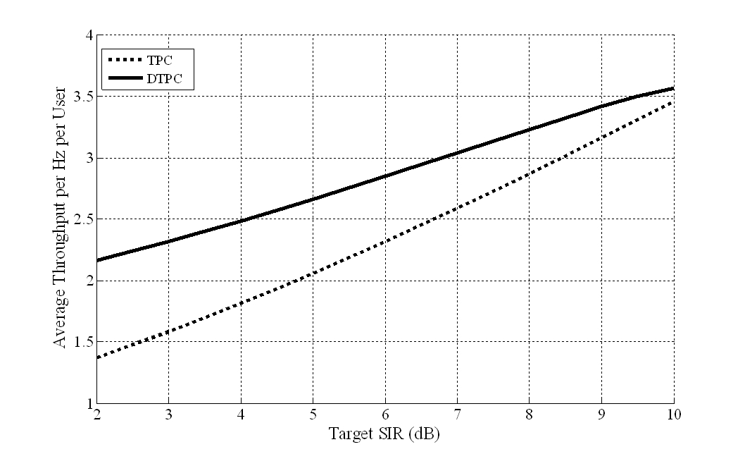
Simulation Results
System throughput per Hz achieved by TPC and DTPC vs. target-SIR

Slide 50
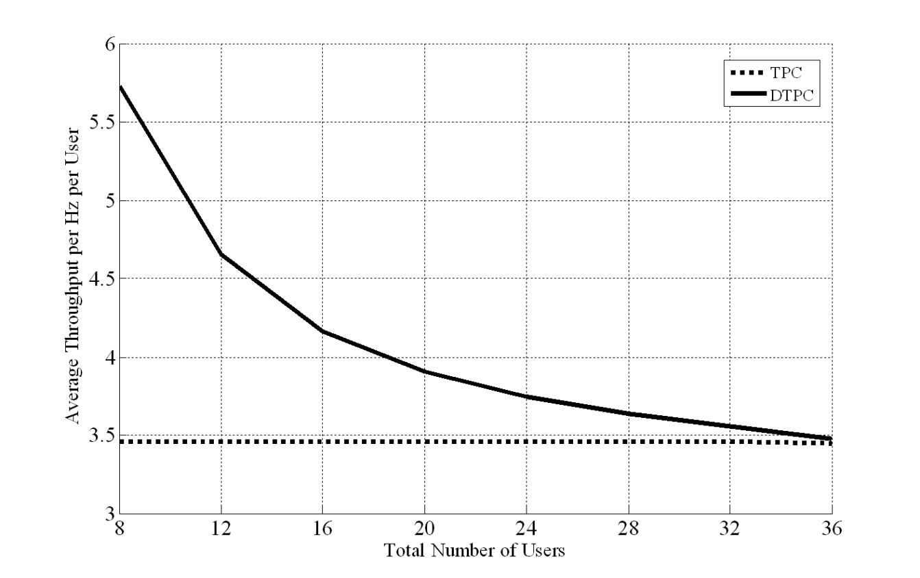
Simulation Results
System throughput per Hz achieved by TPC and DTPC vs. total number of users

Slide 51
A research question:
How does the DTPC work under the transmit power constraint? How to devise a constrained DTPC?
How to increase fairly the SINR of users when the minimum target-SINRs are feasible?

Slide 52
Power Control in Wireless Cellular Networks Lecture 5 Outline
Performance Measures
Why Power Control?
Closed-Loop and Open-Loop Power Control
Different Power Control Optimization Problems
Distributed Power Control Algorithms
Some Open Problems

Slide 53
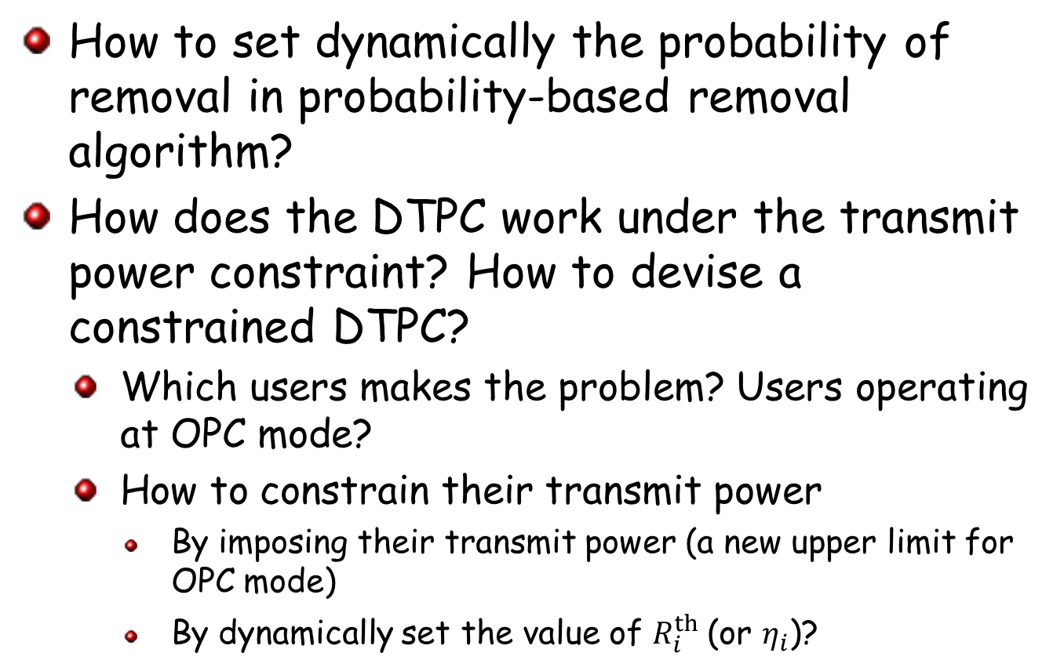
Few Research Questions
How to set dynamically the probability of removal in probability-based removal algorithm?
How does the DTPC work under the transmit power constraint? How to devise a constrained DTPC?
Which users makes the problem? Users operating at OPC mode?
How to constrain their transmit power
By imposing their transmit power (a new upper limit for OPC mode)
By dynamically set the value of $R_{i}^{th}$(or $η_{i}$)?

Slide 54
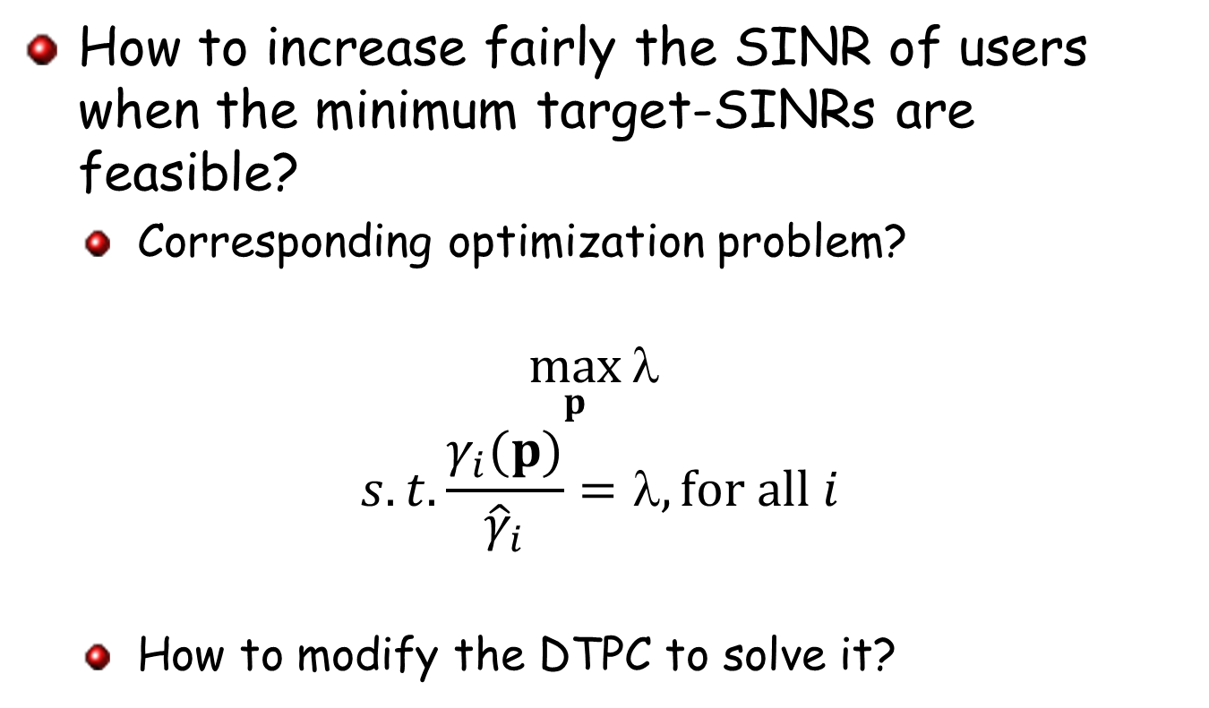
Few Research Questions
How to increase fairly the SINR of users when the minimum target-SINRs are feasible?
Corresponding optimization problem?
$$\max_{p}{λ}$$
$$s.t.\frac{γ_{i}(p)}{{\hat{γ}}_{i}}=λ, for all i$$
How to modify the DTPC to solve it?

Slide 55
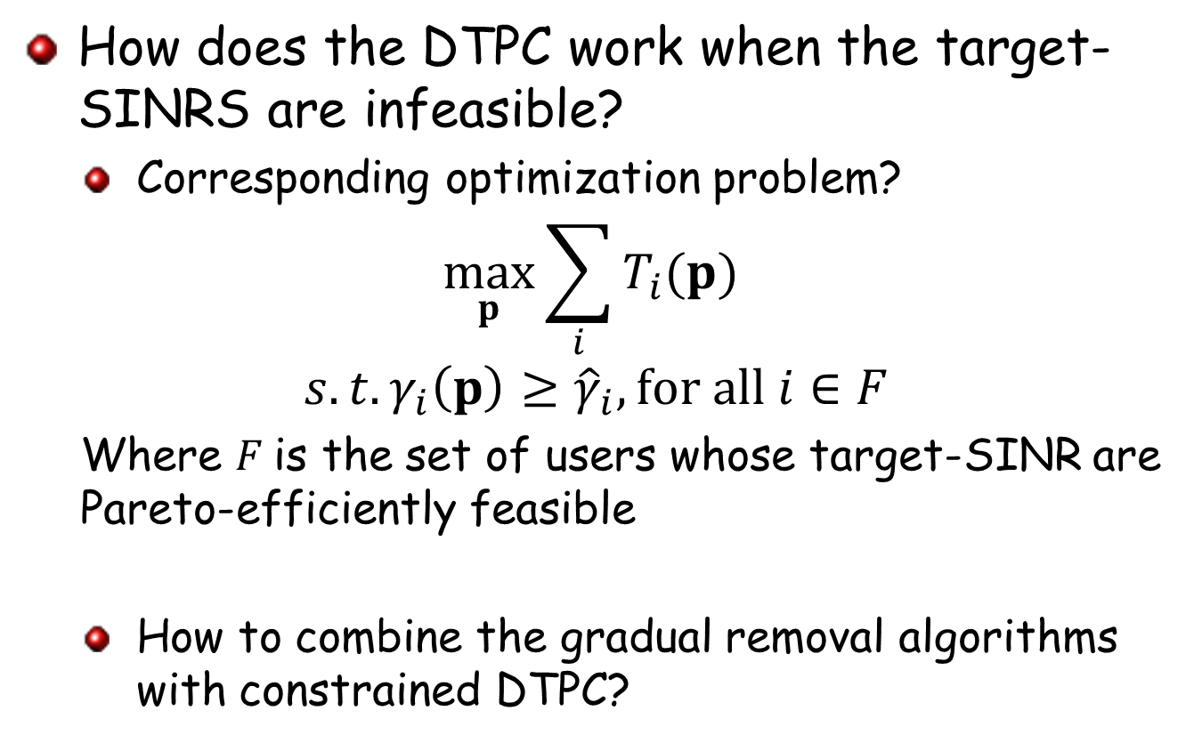
Few Research Questions
How does the DTPC work when the target-SINRS are infeasible?
Corresponding optimization problem?
$$\max_{p}{\sum_{i}{T_{i}(p)}}$$
$$s.t.γ_{i}\left(p\right)≥{\hat{γ}}_{i}, for all i∈F$$
Where $F$is the set of users whose target-SINR are Pareto-efficiently feasible
How to combine the gradual removal algorithms with constrained DTPC?

Slide 56
Open Problems for Power Control
Priority-based gradual removal for
Cognitive radio network
Femtocell networks
Heterogeneous network
Active-link protection
Distributed power control and carrier assignment in a multi-carrier CDMA or OFDMA network
Adding a new constraint and/or considering a new variable
Joint power and rate control using existing distributed power control algorithms
Joint power control and base station assignment

Slide 57
Open Problems
Priority-based gradual removal for
Cognitive radio network
Femtocell networks
Heterogeneous network
Active-link protection
Distributed priority based power control algorithm based on existing distributed power control
Priority based TPC?
Priority based TPC-PR?
Priority based TPC-SR?
Priority based DFC?
Priority based DTPC
Priority based OPC?

Slide 58

You should be always ready to make contribution!

